Slide 1
Principles of Programming Language
Amit Dua
Computer Science and Information Systems Department
BITS, Pilani

Slide 2
Unix File System
Tutorial 3
Slides taken from the ones prepared by Dr. Mayuri Digalwar

Slide 3
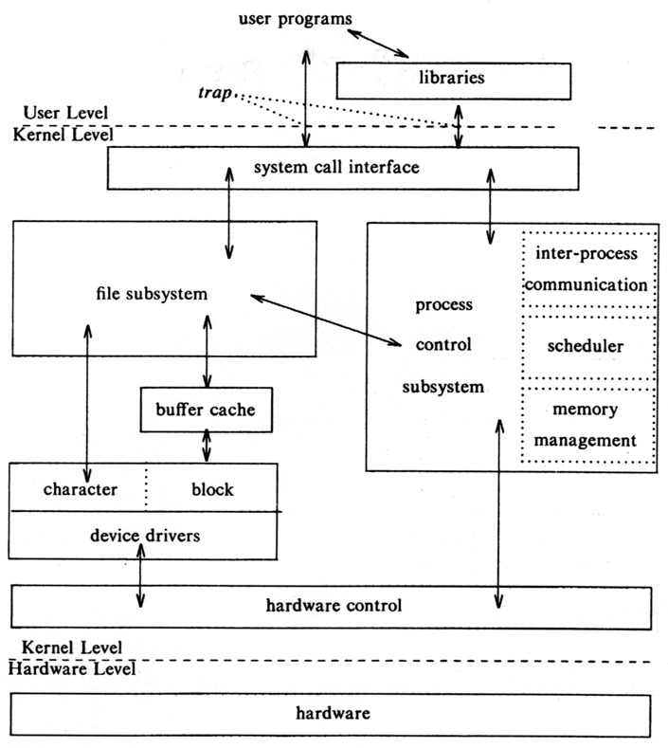
Block Diagram of System Kernel

Slide 4
Unix File Systems
Design Aspects
Types of Files
Hierarchical Organization of Files
Structure of File System
Internal Representation of Files
Related System Calls
Programming

Slide 5
Types of Files
Regular Files
Contain only data. E.g. text file, program file etc.
Directory Files
Act as container and contain regular files and sub directory files entry with their corresponding inodes.
Device Files
These files represent all peripheral devices such as terminals, printers, CD-ROMS, modems, disks etc

Slide 6
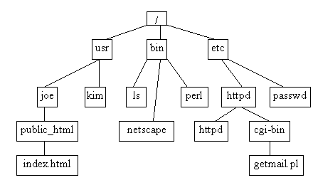
Hierarchical Organization of Files
Unix file system is organized in a tree like fashion
With root node as a root directory “/”
Every non-leaf node – Directory
Every leaf node - Regular or directory or device files

Slide 7
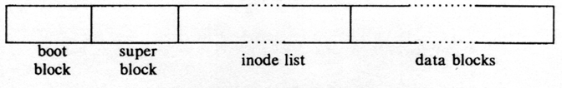
File System Structure
Unix divided physical disks into logical disks called partitions.
Each partition is a standalone file system.
a boot block is located in the first few sectors of a file system. The boot block contains the initial bootstrap program used to load the operating system.
a super block describes the state of the file system: the total size of the partition, pointers to a list of free blocks, a list of free inodes in the file system, etc.
a linear array of inodes (short for “index nodes”). There is a one to one mapping of files to inodes and vice versa.
data blocks contain the actual contents of the file.

Slide 8
Inode
contains the information necessary for a process to access a file
It exits in a static form on disk and the kernel reads them into an in-core inode

Slide 9
Disk Inode
Disk inode consists of :
File owner identifier
Individual owner
Group owner
Set of users – access rights
Super user – access rights to all files
file type (regular, directory or device file)
file access permissions (R, W & E)
file access times (the time - file was last modified, last accessed, when the Inode was last modified)
table of contents for the disk address of data in a file
file size

Slide 10
Sample disk inode
owner mjb
group os
type regular file
perms rwxr-xr-x
accessed Oct 23 1984 1:45 P.M
modified Oct 22 1984 10:30 A.M
inode Oct 23 1984 1:30 P.M
size 6030 bytes
Disk addresses

Slide 11
In-core copy of Inode
in-core copy of the inode contains
status of the in-core inode
Inode is locked
Process is waiting for the inode to become unlocked
In-core representation of the inode differs from the disk copy as a result of a change to the data in the inode
In-core representation of the inode differs from the disk copy as a result of a change to the file data
File is a mount point
logical device number of file system
inode number (stored as a linear array on disk)
pointers to other in-core inodes
reference count (no. of instances of the file are active)

Slide 12
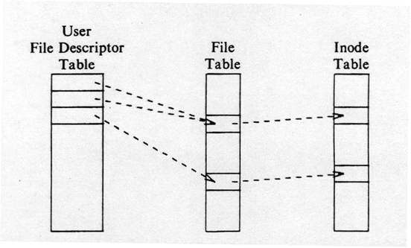
File System – Data Structure

Slide 13
File System Algorithms
Lower Level File system Algorithms
namei
alloc free ialloc ifree iget iput bmap
buffer allocation algorithms
getblk brelse bread bwrite

Slide 14
Accessing the inode : iget algorithm
Algo. iget allocates an in-core copy of an inode
Inode not found,
Allocates one from the free list and locks it
Read the disk copy of the newly accessed inode into the in-core copy
It knows the inode number and logical device – computes logical disk block that contains inode according to how many disk inodes fit into a disk block

Slide 15
Block num =
((inode number – 1) / number of inodes per block)
+ start block of inode list
Example
Block 2 is the beginning of the inode list
There are 8 inodes per block
Then inode number 8 is in disk block 2 and inode number 9 is in disk block 3
If there are 16 inodes in a disk block then inode numbers 8 & 9 are in ---disk block and inode number 17 is in --- disk block

Slide 16
Accessing the inode
Copies the contents from the disk inode to the in-core inode and returns a locked inode
The kernel manipulates the inode lock and reference count independently.
The lock is set – execution of a system call to prevent other accesses
It releases the lock at the conclusion of the system call

Slide 17
Structure of a Regular File
Table of contents in an inode
Location of a file’s data on disk
A set of disk block #
Each block on a disk is addressable by number
Not contiguous file allocation strategy
Why ?
When a file expand or contract…
Fragmentations occur

Slide 18
Sample - Fragmentation
….
File A
File B
File C
…….
40
50
60
70
….
File A
Free
File C
File B
…….
40
50
60
70
85
File B was expanded
Garbage collection – too high cost

Slide 19
Direct and indirect blocks in inode
Inode
Data Blocks
direct0
direct1
direct2
direct3
direct4
direct5
direct6
direct7
direct8
direct9
single indirect
double indirect
triple indirect

Slide 20
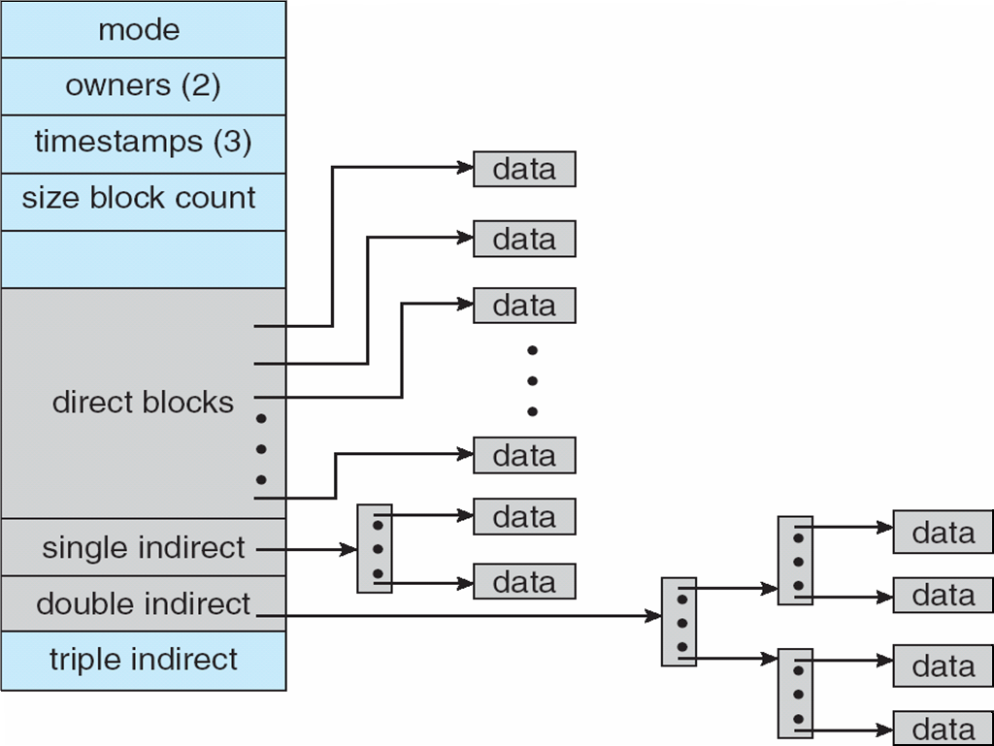
Direct and indirect blocks in inode

Slide 21
Suppose System V UNIX
Assume that a logical block on the file system holds 1K bytes and that a block number is addressable by a 32 bit integer, then a block can hold up to 256 block numbers
13 entries in the inode table of contents
10 direct, 1 indirect, 1 double indirect, 1 triple indirect block
Assume
a logical block = 1K bytes
a block number is addressable by a 32 bit (4 bytes) integer
a block can hold up to 256 block numbers
Byte Capacity of a File
10 direct blocks with 1K bytes each= 10 Kbytes
1 indirect block with 256 direct blocks= 1K*256= 256 Kbytes
1 double indirect block with 256 indirect blocks=256K*256= 64 Mbytes
1 triple indirect block with 256 double indirect blocks=64M*256=16 Gbytes

Slide 22
Processes
access data in a file by byte offset
view a file as a stream of bytes
The kernel
accesses the inode
converts the logical file block into the appropriate disk block
Algorithm bmap is used to map File byte offset to physical disk block

Slide 23
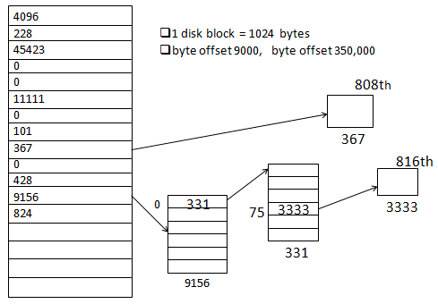
Block Layout of a Sample File and its Inode
23

Slide 24
Example
Disk block size = 1024 bytes or 1KB
4bytes are required to store one block number
256 block numbers can be stored in one index block (1024/4)
If a process makes a request to access 9000 byte offset, then find out which index block contains this byte information.
9000 / 1024 = 8 , 9000 mod 1024 = 808
That means 9000 – 808 = 8192 byte offset is last offset in 8th index block
Since 808 < 1024 , therefore byte offset 9000 is surely present in 9th index block with block no. 367 and in 808th byte

Slide 25
If a process makes a request to access 350,000 byte offset, then find out which index block contains this byte information.
First 10 direct blocks can access 10240 bytes or 10K bytes.
350,000 > 10240, therefore lets look into single indirect block.
Single indirect can address 256 blocks, each block contains 1024 bytes, so 256 * 1024= 262144 bytes can be accessed = 256KB
So 10 K + 256 K = 266 K = 272,384 bytes
Still 350,000 > 272,384 , Go ahead and search in double indirect.
350,000 – 272,384 = 77,616 byte no in double indirect.
First entry in double indirect block points to first single indirect block which holds 256 block nos and hence points to 256K byte addresses i.e 262,144 byte address.
Since 77,616 < 262,144, 350,000 will be there in one of the blocks pointed to by single indirect.
It comes out to be 75th block and 816th byte entry.

Slide 26
Directories
A directory is a file
It gives hierarchical structure to the file system
Play an important role in conversion of a file name to an inode number
Its data is a sequence of entries
Contents of each entries
an inode number and the name of a file
Path name is a null terminated character string divided into components by slash (“/”)
Each component must be the name of a directory and last may not be
UNIX System V
Maximum of component name : 14 characters
Inode number entry : 2 bytes
Size of a directory entry : 16 bytes

Slide 27
Fig Directory layout for /etc
Byte Offset in Directory | Inode Number (2 bytes) | File Name
0 16 32 48 64 80 96 112 128 144 160 176 192 208 224 240 256 | 83 2 1798 1276 85 1268 1799 88 2114 1717 1851 92 84 1432 0 95 188 | .. init fsck clri motd mount mknod passwd umount checklist fsdblb config getty crash mkfs inittab

Slide 28
File System Algorithms
Lower Level File system Algorithms
namei
alloc free ialloc ifree iget iput bmap
buffer allocation algorithms
getblk brelse bread bwrite

Slide 29
Lower level File System Algorithms
Name of Algorithm | Operation
namei | Parses the path name one component at a time and returns the inode of the input path name.
iget | Allocates the in-core copy of the inode if it exist and locks it. The inode is returned with reference count 1 greater than previous.
iput | Releases the inode by decrementing the reference count. Unlocks the inode to provide access to other system calls. Stores back if in-core copy is different from disk copy.
bmap | Converts a file byte offset into a physical disk block.
ialloc | Allocates the inode for a new file from the free list of inodes
ifree | If reference count becomes 0, the inode is released and added to the free list of inodes
alloc | Allocates the disk inode
free | Releases the disk inode

Slide 30
Questions

